Slide 1
Computer Logic & Design
Lecture 04
Copyrights: Dr Waseem Ikram

Slide 2
Recap
Octal Number System
Alternate Representations
  Excess Code
  BCD Code
  Gray Code
Alphanumeric Code (ASCII)
Error Detection using Parity Bit

Slide 3
Logic Gates
Basic Building Blocks
Logic Gate Symbol
Unique function
Truth or Function Table
Function Expression
Timing Diagram

Slide 4
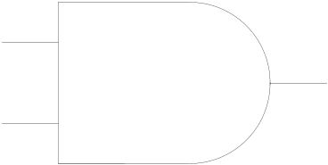
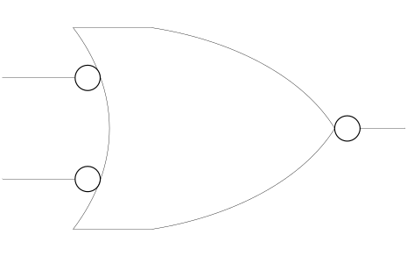
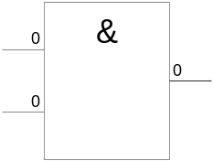
AND Gate
1 output
2 inputs
3 inputs
4 inputs
Multiple inputs

Slide 5

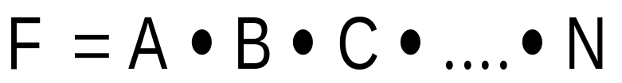
AND Gate function
Logical Multiplication function
Input |  | Output
A | B | F
0 | 0 | 0
0 | 1 | 0
1 | 0 | 0
1 | 1 | 1

Slide 6
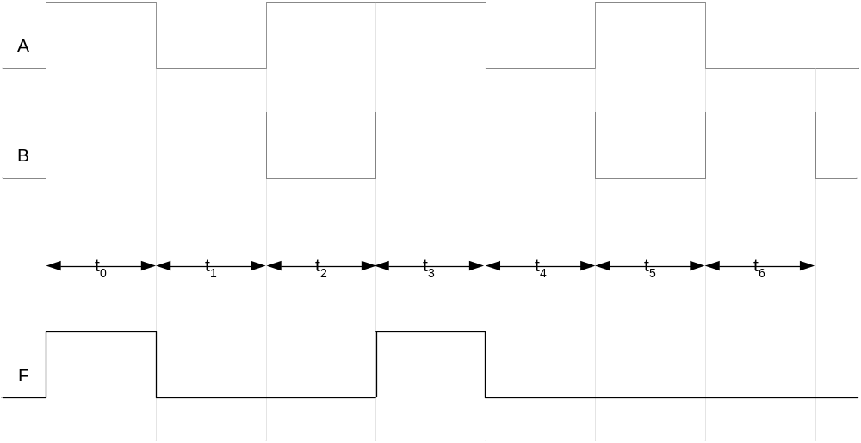
AND Gate Timing Diagram

Slide 7
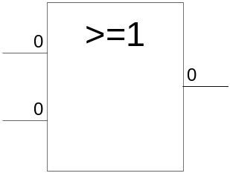

OR Gate
1 output
2 inputs
3 inputs
4 inputs
Multiple inputs

Slide 8

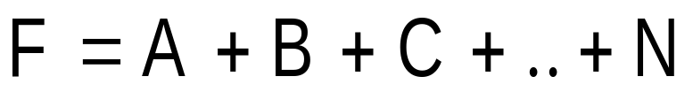
OR Gate function
Boolean Add function
Input |  | Output
A | B | F
0 | 0 | 0
0 | 1 | 1
1 | 0 | 1
1 | 1 | 1

Slide 9
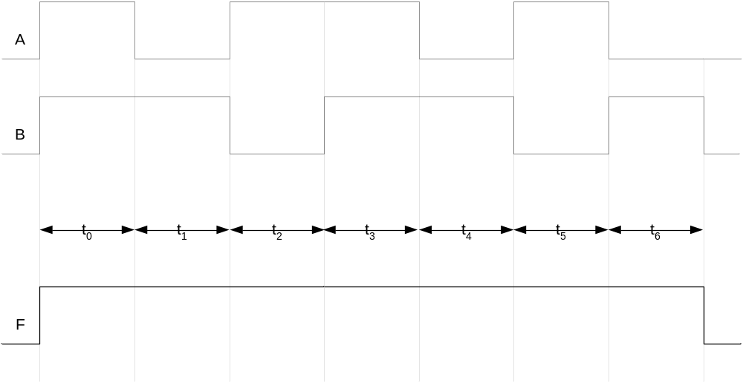
OR Gate Timing Diagram

Slide 10
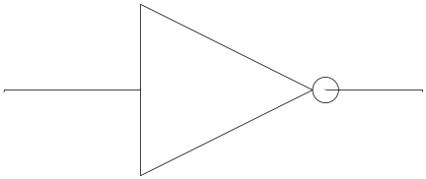
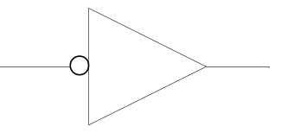
NOT Gate
1 input
1 output

Slide 11
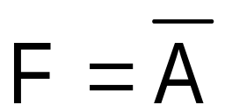
NOT Gate function
Invert function
Input | Output
A | F
0 | 1
1 | 0

Slide 12
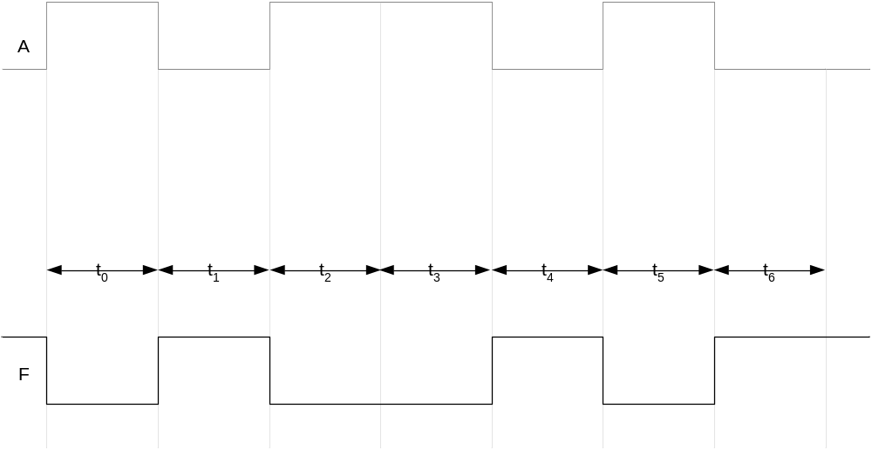
NOT Gate Timing Diagram

Slide 13
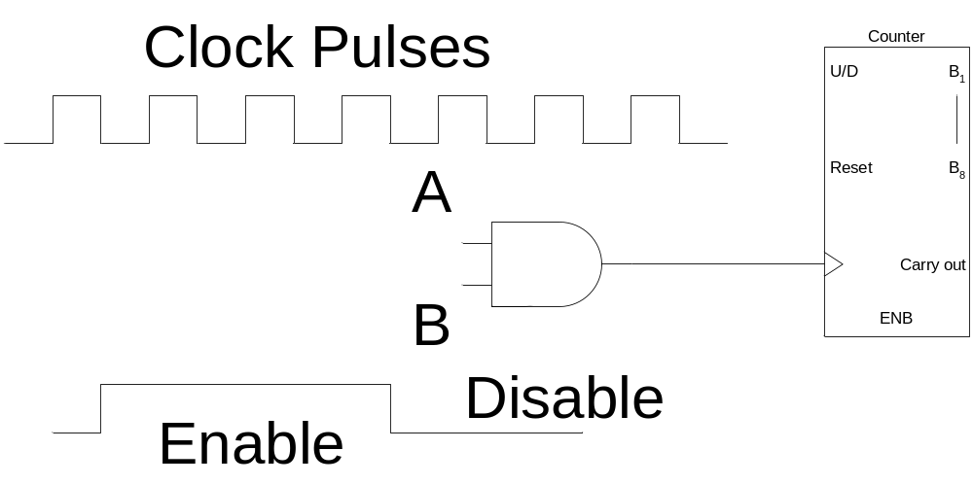
AND Gate Applications
Enable/Disable Device
  Counter counts when it receives pulses

Slide 14
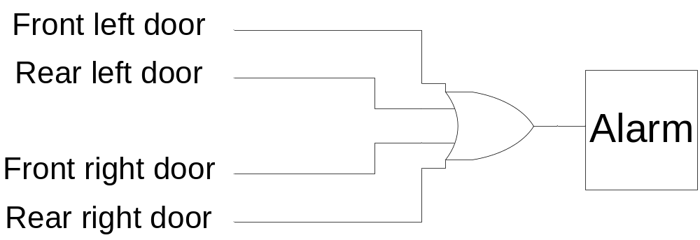
OR Gate Applications
Car door open alarm

Slide 15
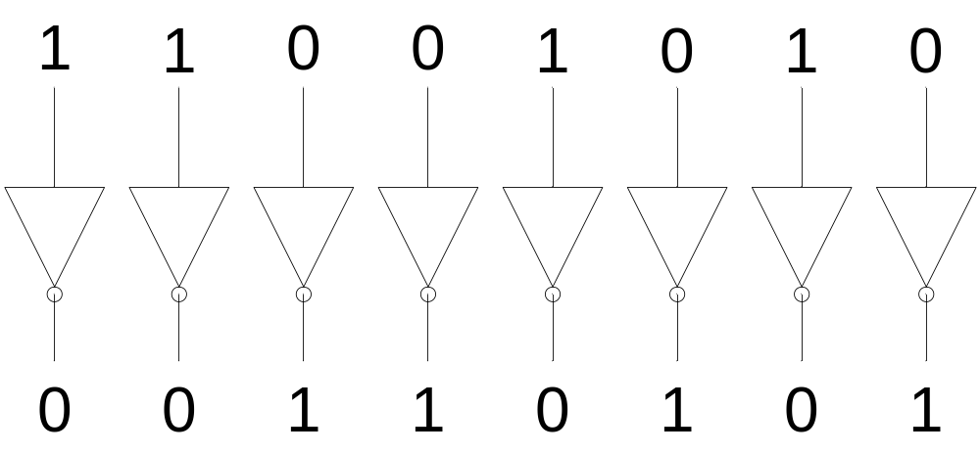
NOT Gate Applications
1’s Complement

Slide 16
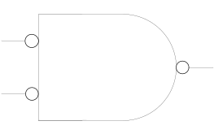
Alternate Representations

Slide 17
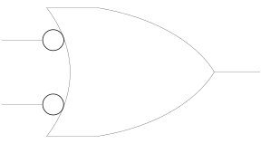
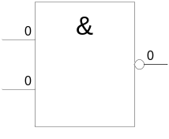
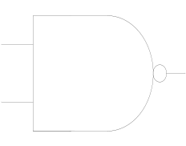
NAND Gate
1 output
2 inputs
3 inputs
4 inputs
Multiple inputs

Slide 18
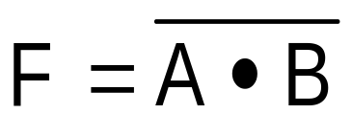
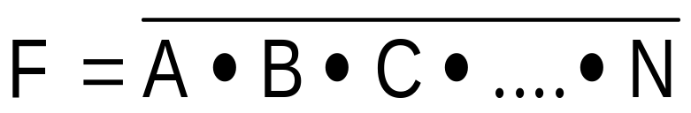
NAND Gate function
NOT-AND function
Input |  | Output
A | B | F
0 | 0 | 1
0 | 1 | 1
1 | 0 | 1
1 | 1 | 0

Slide 19
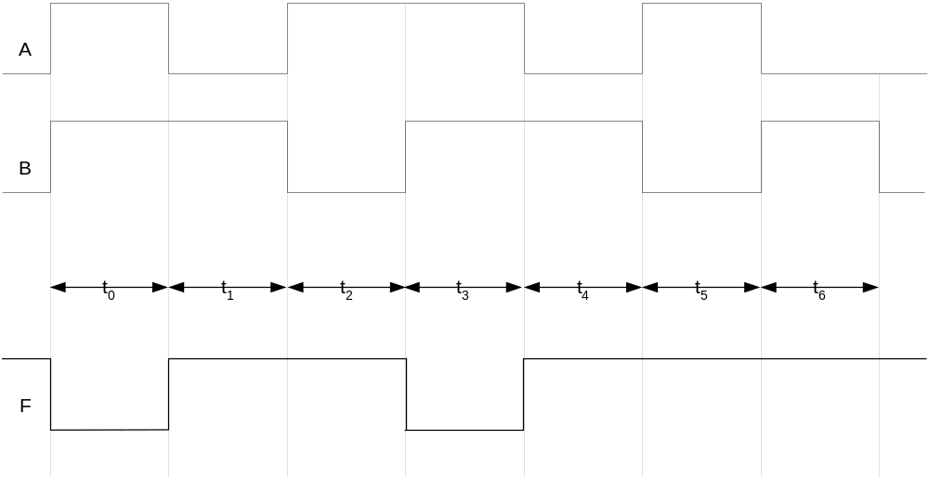
NAND Gate Timing Diagram

Slide 20
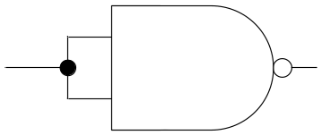
NAND Universal Gate
Input |  | Output
A | B | F
0 | 0 | 1
0 | 1 | 1
1 | 0 | 1
1 | 1 | 0

Slide 21
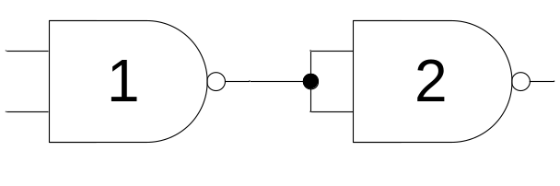
NAND Universal Gate
Input |  | Output | Output
A | B | F1 | F
0 | 0 | 1 | 0
0 | 1 | 1 | 0
1 | 0 | 1 | 0
1 | 1 | 0 | 1

Slide 22
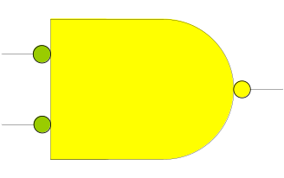
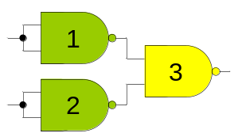
NAND Universal Gate
Input |  | Output
A | B | F
0 | 0 | 0
0 | 1 | 1
1 | 0 | 1
1 | 1 | 1

Slide 23
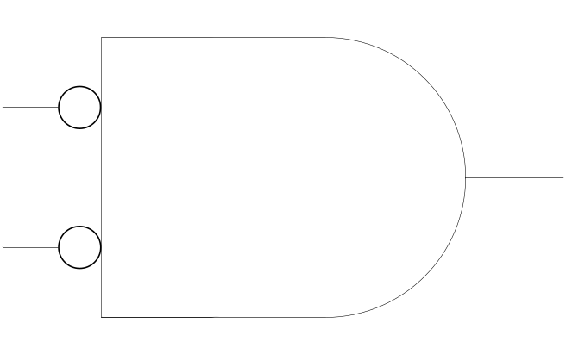
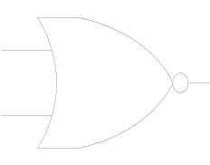
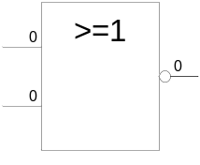
NOR Gate
1 output
2 inputs
3 inputs
4 inputs
Multiple inputs

Slide 24
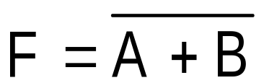
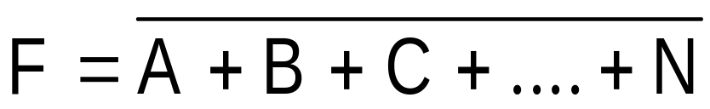
NOR Gate function
NOT-OR function
Input |  | Output
A | B | F
0 | 0 | 1
0 | 1 | 0
1 | 0 | 0
1 | 1 | 0

Slide 25
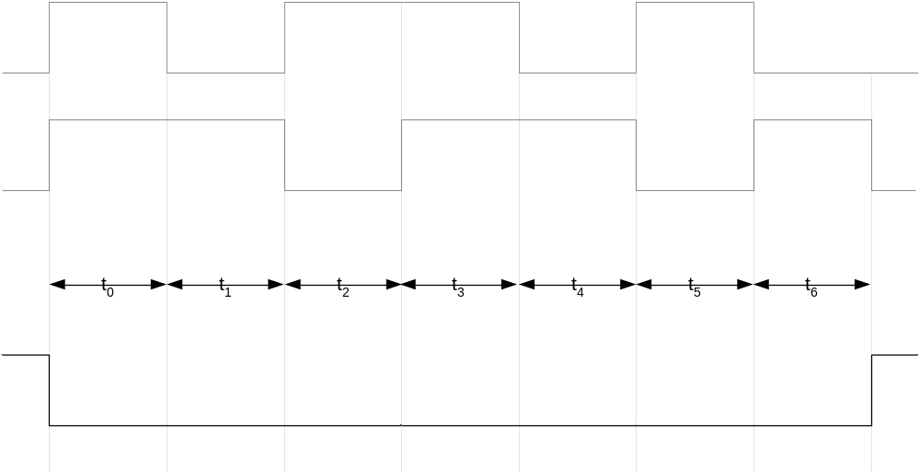
NOR Gate Timing Diagram

